Slide 1



UNIVERSAL CHARGER FOR MODERN DEVICES
Guided By
Dr.K Sheikdavood
Presented By
AKSHAYA N S (927623BEC006)
BHARATHI S (927623BEC018)
DHAARANI T(927623BEC026)

Slide 2

PROBLEM STATEMENT
People use many electronic devices, and each device needs a different charger. Carrying multiple chargers is inconvenient, unsafe, and creates e-waste. Normal chargers cannot adjust voltage or current automatically, do not identify the connected device, and do not provide any safety or monitoring features. So, there is a need for one smart universal charger that can work with any device, adjust power safely, and give real-time information.

Slide 3
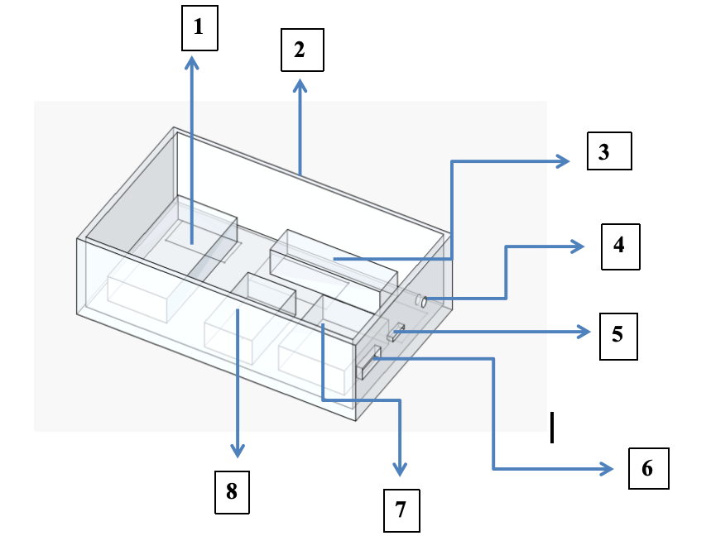
PROBLEM SOLUTION
The solution is to build a smart universal charger that can automatically adjust voltage and current for any device using USB-C PD negotiation and a buck-boost converter, while also providing interchangeable output ports like USB-C and a barrel jack. This allows the same charger to power smartphones, laptops, IoT boards, and even small DC devices. With real-time monitoring, safety protection, and IoT logging, the charger delivers the correct power safely, replaces multiple adapters, improves convenience, and reduces e-waste.
1) OLED Display 2) Outercase 3) LTC3780 ( Buck Booster) 4) Barrel Jack 5) USB - C Port 6) USB - A Port 7) ESP32(Microcontroller) 8) Current Sensor

Slide 4
LITERATURE SURVEY
S.NO | AUTHOR | TITLE | YEAR | REMARKS
[1] | J. Smith | USB-C Power Delivery: A Universal Charging Standard | 2019 | Explains the evolution of USB-C PD and how dynamic voltage profiles improve device compatibility and charging efficiency across multiple platforms.
[2] | R. Kumar | Adaptive Buck-Boost Converters for Smart Power Systems | 2021 | Describes how buck-boost converters ensure stable voltage regulation under varying loads, directly supporting flexible multi-device charging systems.
[3] | L. Chen | Real-Time Power Monitoring Using INA-Series Sensors | 2020 | Demonstrates real-time voltage and current sensing for safety, fault detection, and power optimization—essential for smart chargers.
[4] | M. Vega | IoT-Enabled Energy Monitoring and Logging Systems | 2022 | Highlights the importance of cloud-based monitoring for tracking power consumption, improving device safety, and enabling predictive maintenance.
[5] | A. Patel | Multi-Port Charging Architecture for Universal Power Systems | 2023 | Focuses on multi-output architectures like USB-C and barrel jacks, addressing compatibility issues and supporting both modern and legacy devices in one system.

Slide 5
INTRODUCTION
The system intelligently detects the connected device and automatically negotiates the required voltage and current using USB-C Power Delivery.
A buck-boost converter dynamically regulates the output to ensure stable and safe charging across a wide range of devices.
With interchangeable output ports such as USB-C and a barrel jack, the charger supports both modern electronics and traditional DC-powered devices.
Real-time monitoring of voltage, current, and power enables early detection of abnormal conditions like over-load, short-circuit, or overheating, allowing the system to instantly cut off or adjust the output to protect the device.
This smart, adaptive approach enhances safety, improves charging efficiency, reduces the need for multiple chargers, and extends the lifespan of connected devices while minimizing e-waste.

Slide 6
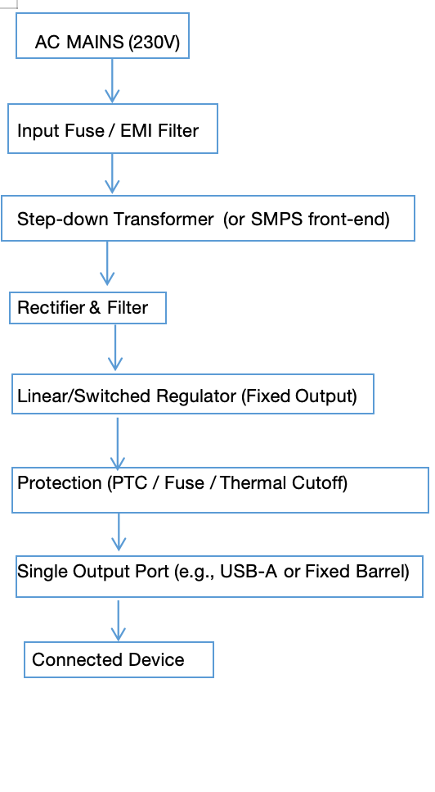
EXISTING SYSTEM
Supports only fixed voltage and current levels
No device recognition or power negotiation
Single dedicated output port (mostly USB-A)
Faults like short-circuit or overheating not detected early
Charging efficiency depends on device compatibility
Safety and reliability are moderate
Users need separate chargers for each device

Slide 7
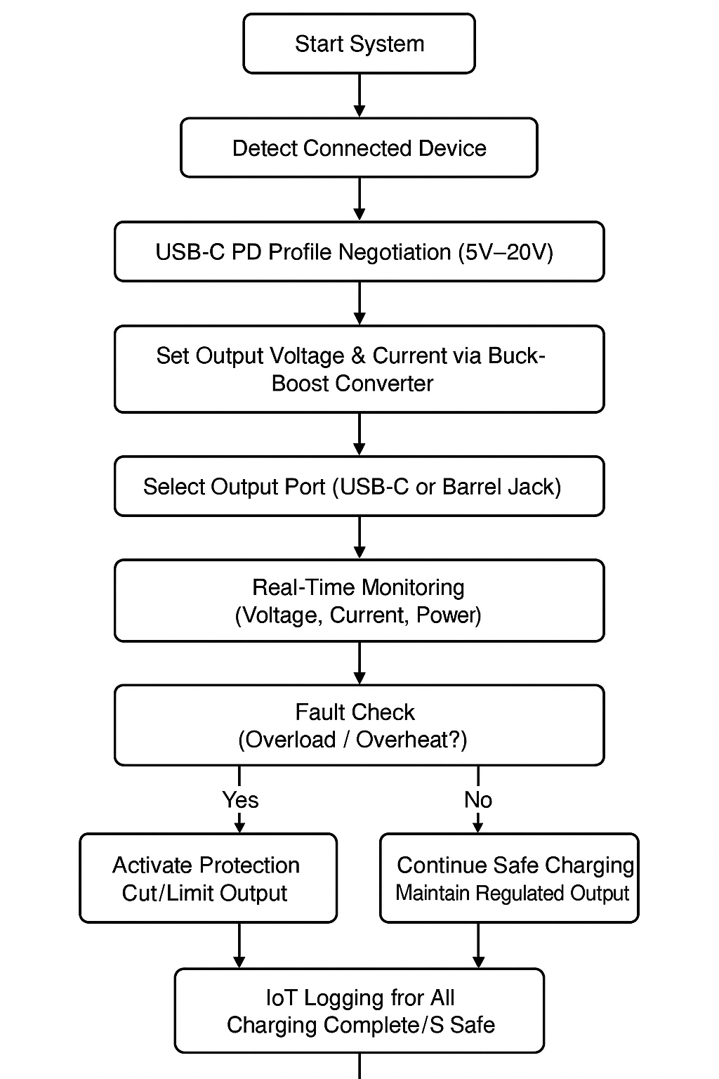
PROPOSED SYSTEM
Automatic USB-C PD profile negotiation (5V to 20V)
Adjustable voltage and current via buck-boost converter
Interchangeable output ports: USB-C + Barrel Jack
Real-time monitoring of voltage, current, and power
Automatic protection against overload and overheating
IoT connectivity for data logging and device health tracking
One charger for all devices → reduces cost and e-waste

Slide 8
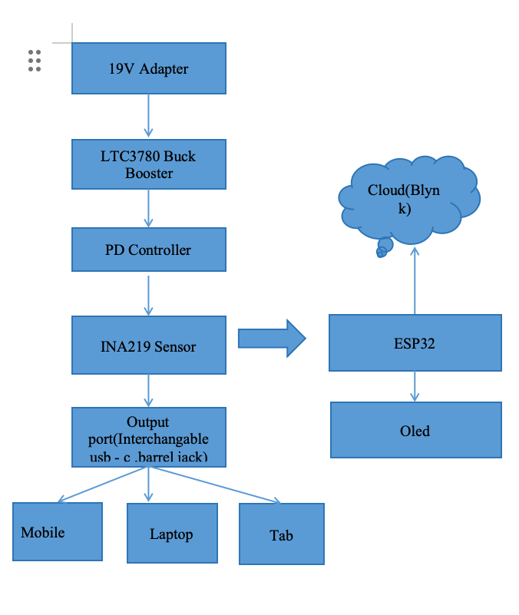
BLOCK DIAGRAM

Slide 9
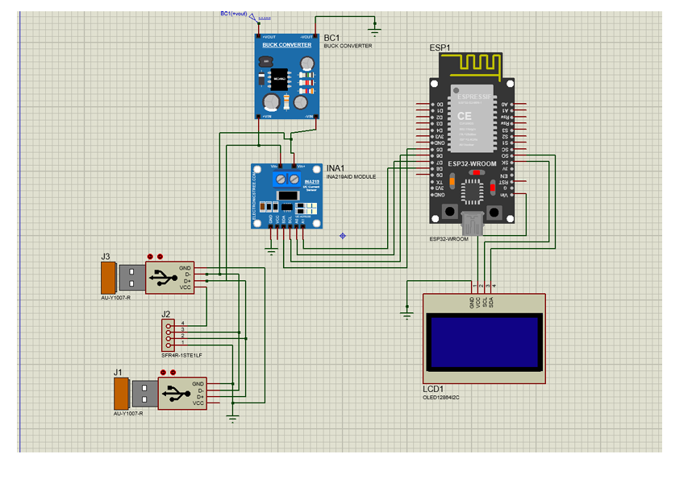
SIMULATION RESULTS

Slide 10
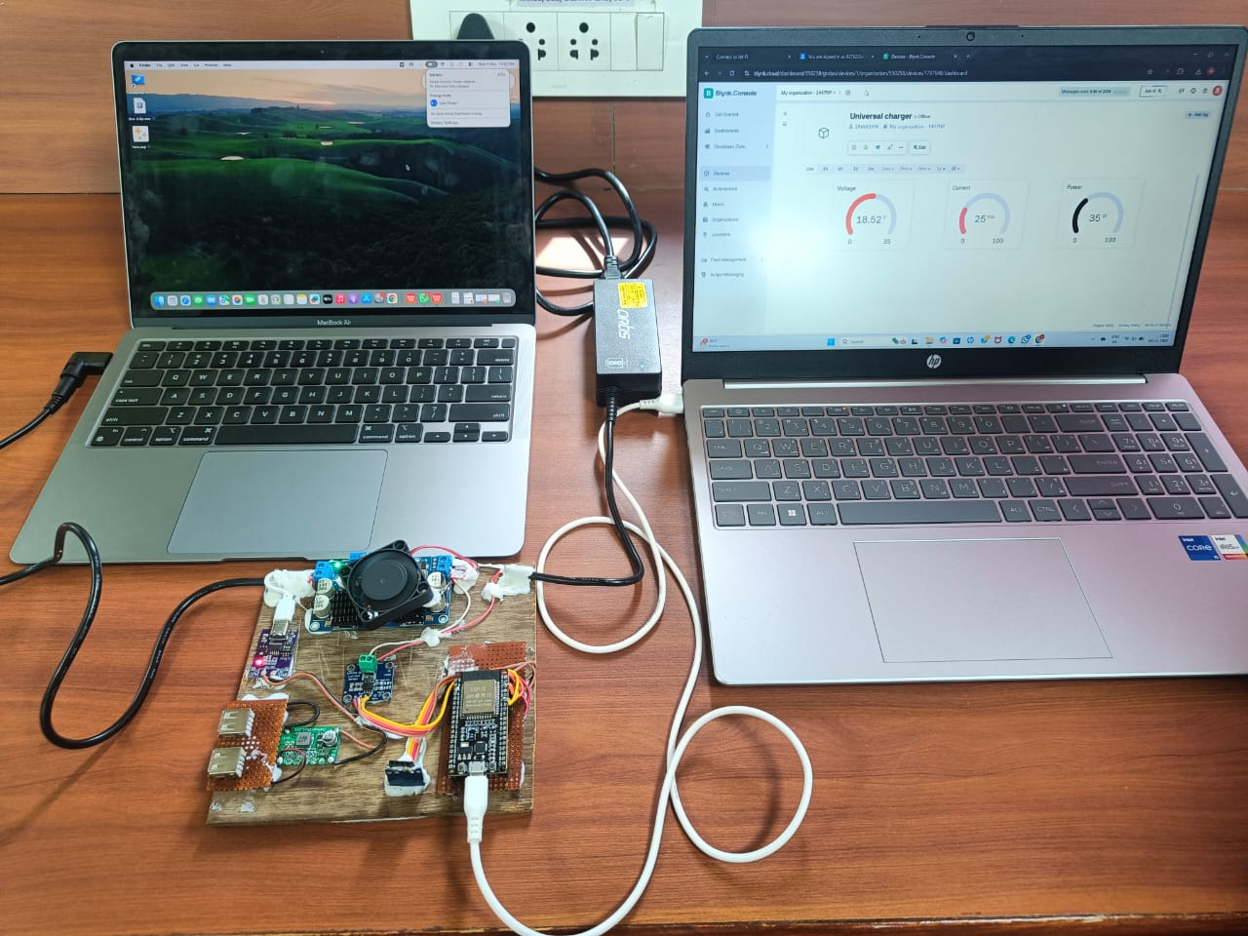
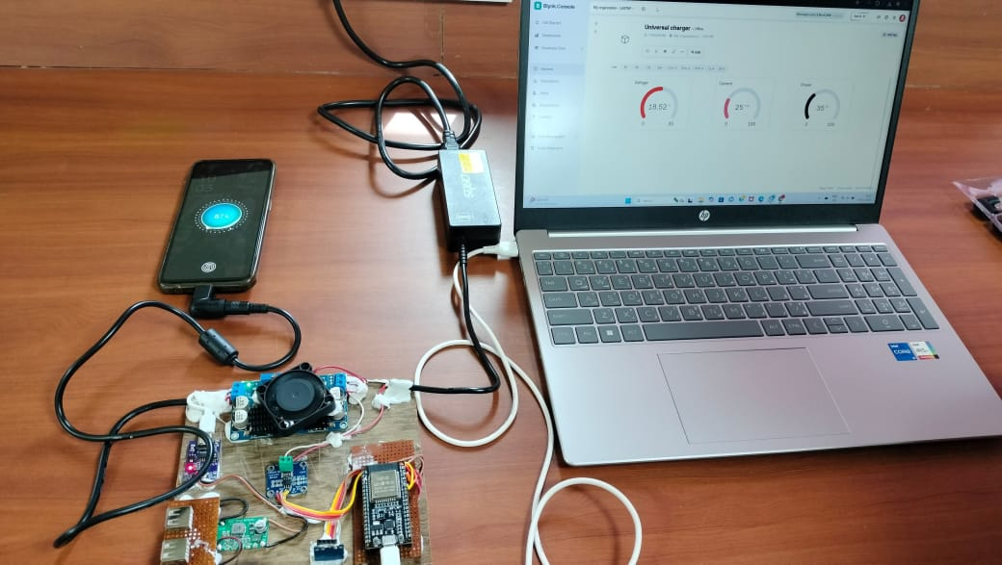
HARDWARE DESIGN

Slide 11
COMPONENTS USED
Microcontroller (ESP32): Controls the charger, monitors sensors, and sends data to the cloud.
STUSB4500: Automatically negotiates the correct USB-C Power Delivery voltage (5V–20V).
LTC3780: Regulates the output by stepping voltage up or down through buck-boost conversion.
INA219: Measures real-time voltage, current, and power for monitoring and safety.
0.96" OLED Display: Shows live charging information like voltage, current, and power.
USB-C & Barrel Jack Ports: Provide interchangeable output options for different types of devices.
Level Shifter & Connectors: Ensure proper voltage compatibility and safe connections between components.
20V Adapter: Supplies the main input power for generating all USB-C PD output levels.

Slide 12
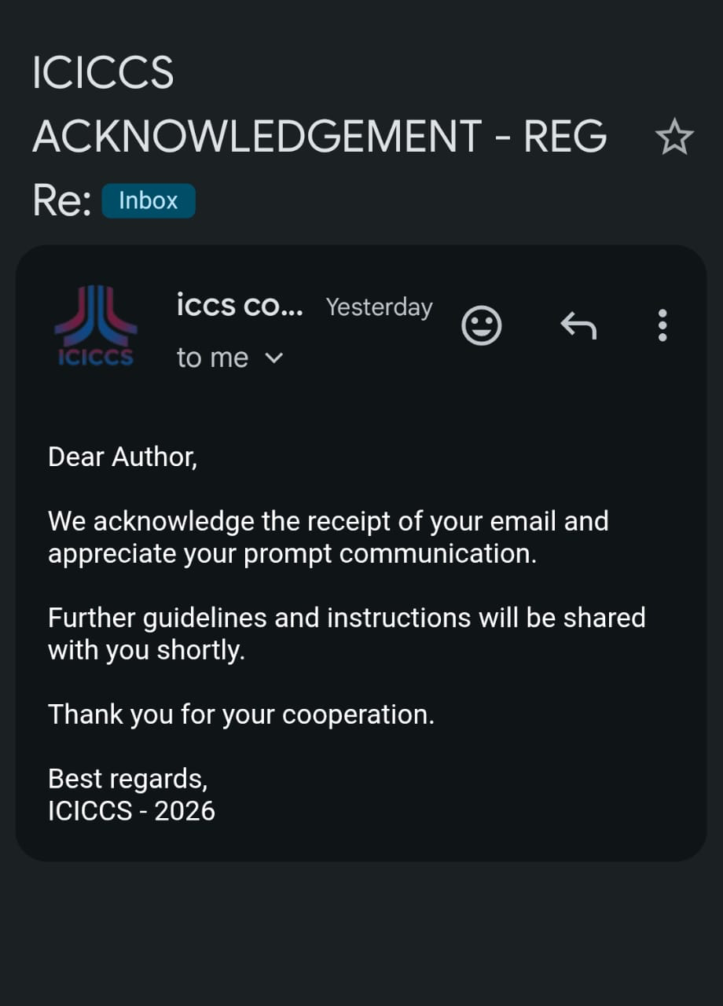
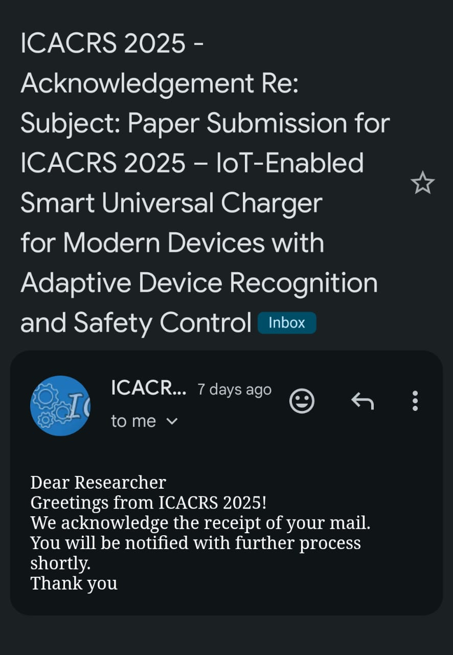
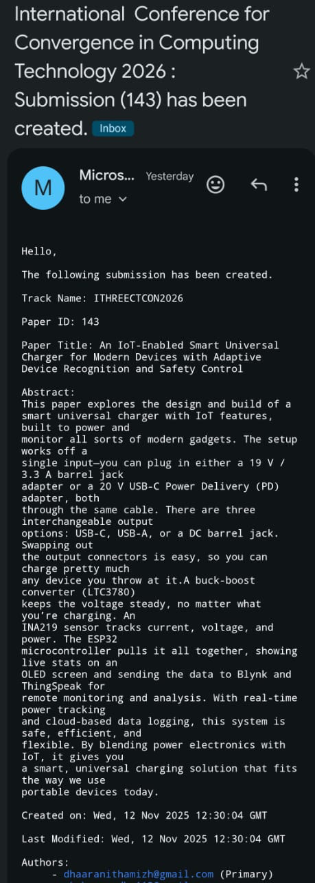
OUTCOME

Slide 13
CONCLUSION
The smart universal charger provides an efficient and safe charging solution for a wide range of devices by using USB-C Power Delivery, adaptive voltage regulation, and real-time monitoring. With interchangeable output ports and automatic protection features, the system ensures reliable charging while reducing hardware redundancy. This innovation improves convenience, enhances safety, reduces e-waste, and offers a modern, intelligent alternative to traditional chargers. It also enables IoT-based data logging for better energy tracking and device health analysis. Additionally, the system’s modular design allows easy upgrades and customization for future charging standards.

Slide 14
REFERENCE
Y. Chen et al., “Parameter-Independent Battery Control Based on Series and Parallel Impedance Emulation,” IEEE Transactions on Industrial Electronics, 2024.
R. Gupta et al., “Transmitter Side Control of a Wireless EV Charger Employing IoT,” IEEE Access, 2023.
L. Wang et al., “Design and Experimental Verification of a Bidirectional EV On-Board Charger Featuring Multiphase Operation,” IEEE Trans_x0002_actions on Power Electronics, 2022.
T. Sato et al., “A High-Efficiency Isolated Wide Voltage Range DC–DC Converter Using WBG Devices,” IEEE Transactions on Power Delivery, 2023.
S. Bhatia et al., “A Comprehensive Study on Fast Charging in Smart_x0002_phones,” IEEE Consumer Electronics Magazine, 2023

